Slide 1
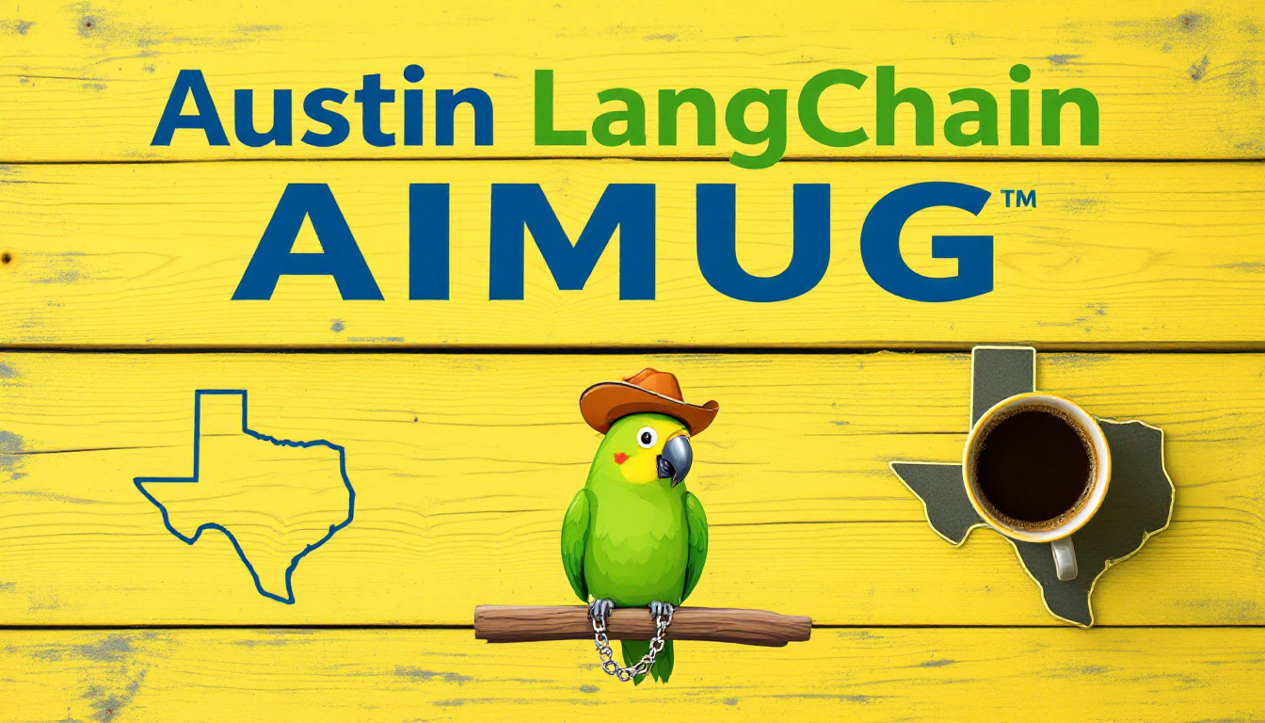











Slide 2

Todays Agenda
Intros
News
Lightning Talks – AI Nuclear Fine Tunes
Lightning Talk – AI Ecosystem Update
Showcase – AI Software Tox Testing MCP
Panel – LangChain Interrupt Conference
Wrap up and after party upstairs at The Tavern

Slide 3
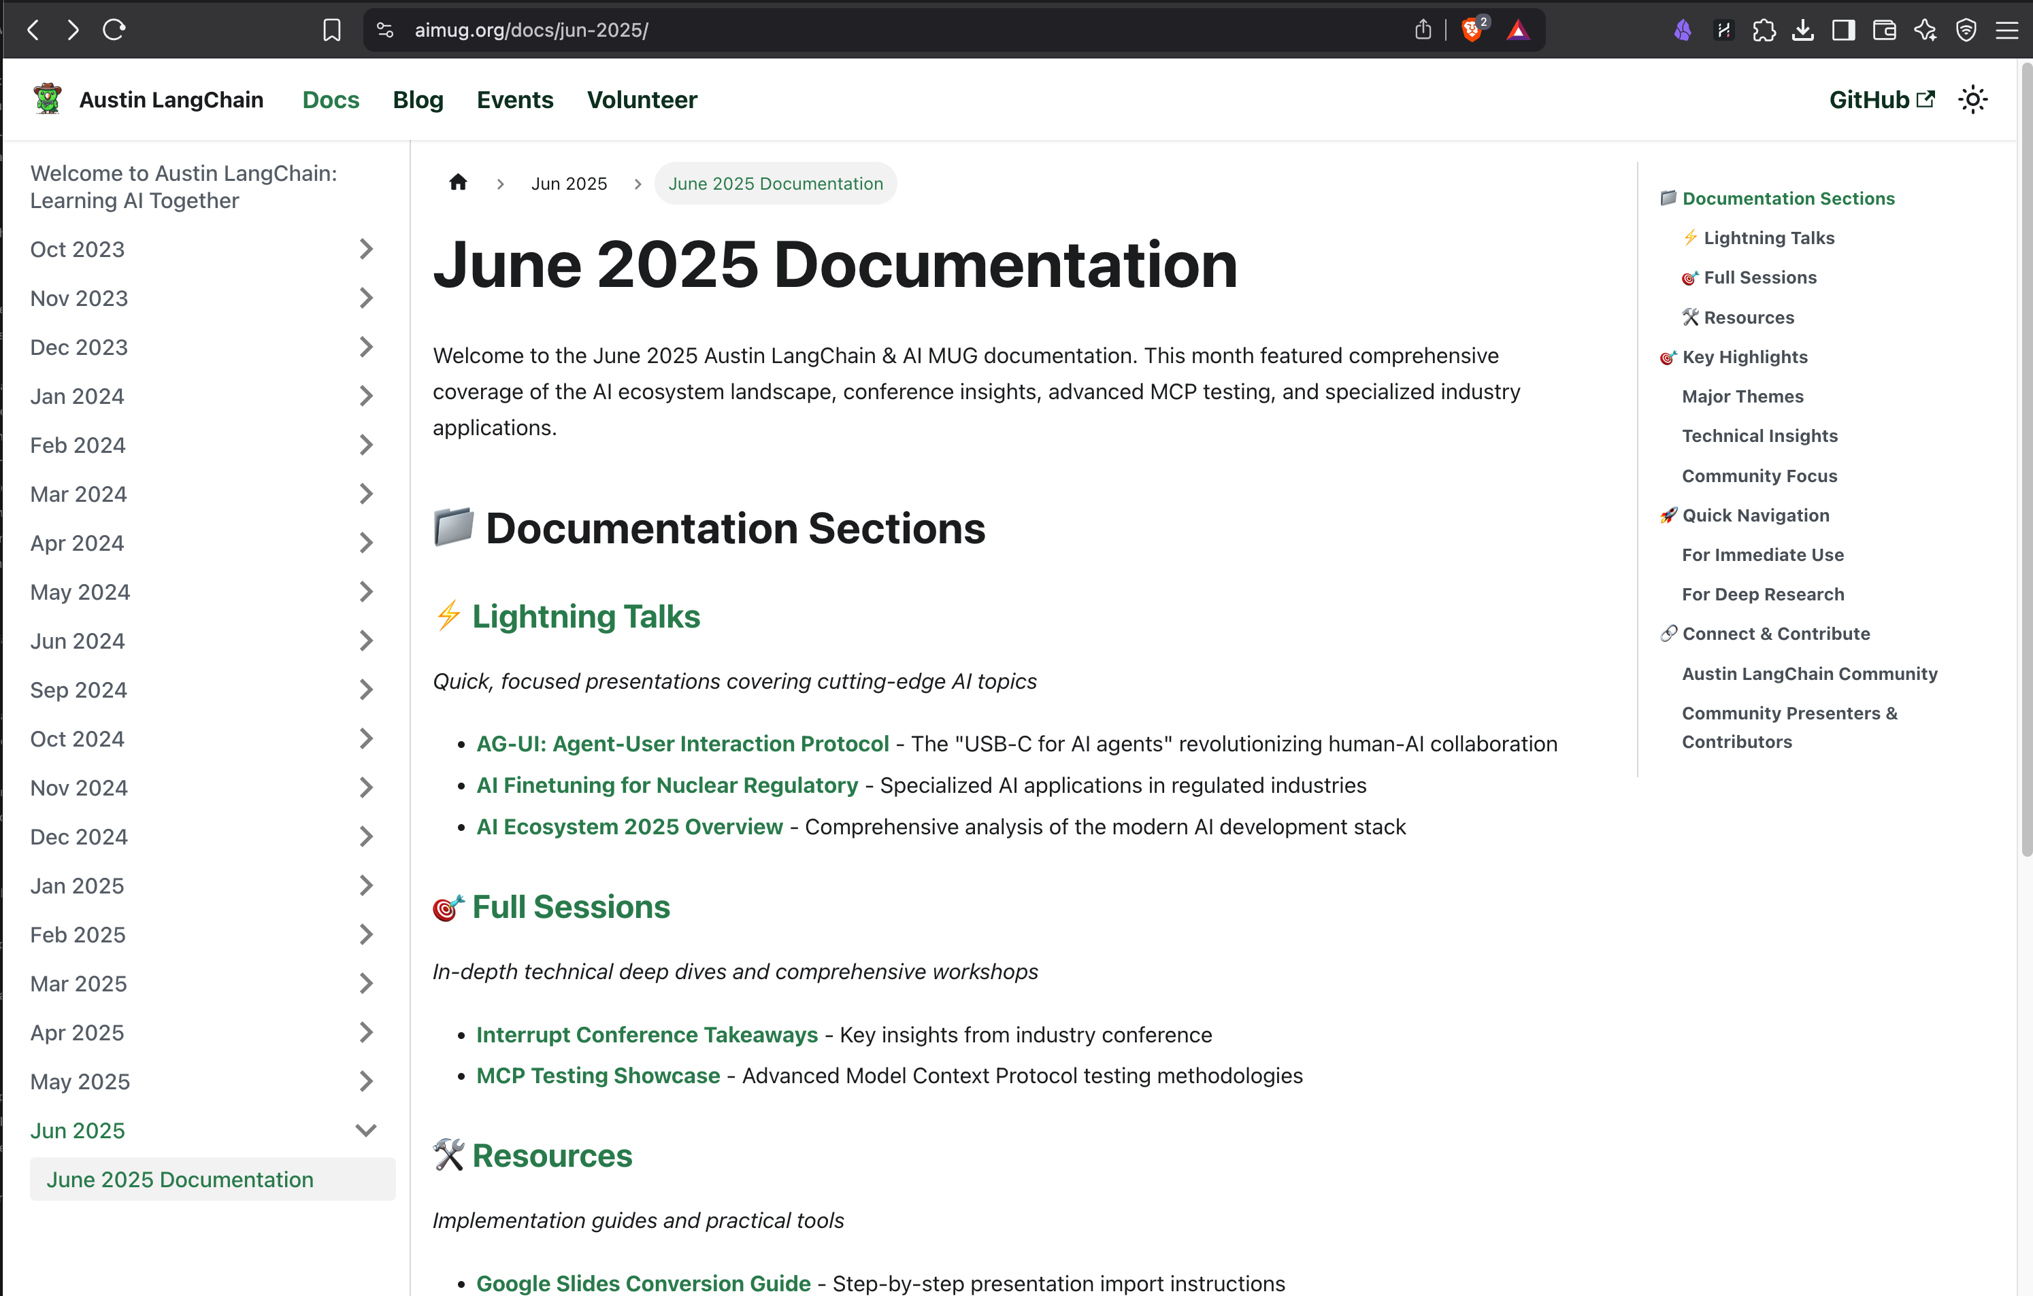
Open AIMUG.ORG – Docs – June 2025
Aimug.org
Docs
June 2025

Slide 4

Thanks to our supporters
Center for Government and Civil Services
LangChain – Pizza
Always Cool AI
Our Community (you)

Slide 5
HI , I’m Colin McNamara
Entrepreneur: Co-founder of Always Cool AI Focusing on Ethical AI across industries such as private-label products and health-conscious goods (LangChain User)
Founding Member: Austin LangChain AIMUG
50% Developer Consulting Engineer, Cloud Builder, Casual Coder
Public Good: Helping our community succeed
LinkedIn:

Slide 6
Who we are
1200+ Members Strong: Connecting Austin’s tech, creative, and business leaders passionate about AI.
Learning in the Open: Leaning AI through the Lense of LangChain, pulling the ecosystem together.
Supportive & Engaged Community: A well-balanced Discord that’s "useful, but not overwhelming."

Slide 7
Learning in the Open – "Be Cool to Each Other" ✌️
Respect & Inclusivity: Our only rule is simple: “Be cool to each other, don’t be gross.”
AI Enthusiasts of All Levels Welcome: We celebrate diverse perspectives and unique paths in AI.

Slide 8
Where and when we meet 🌟📅
Monthly Showcases, Labs & Mixer - ACC RGC3000: Community members and vendors share projects, demos, and labs for hands-on learning.
Hacky Hours (ad hoc) - Rotating Local Bars: Informal happy hours at local spots; meet, discuss, and relax.
Weekly Virtual Syncs - Online: Tuesdays at 5PM – Workshopping, problem-solving, and AI discussions.

Slide 9
Where to Connect & Stay Updated 📲
Website: aimug.org – All things LangChain and AIMUG.
Discord: Join us for ongoing conversations.
GitHub: Austin LangChain Repo – Check out our open-source projects.
Meetup: Austin LangChain Group
Twitter: @AustinLangChain – Latest updates and AI news.
YouTube: Austin LangChain Channel – Watch replays and tutorials.

Slide 10
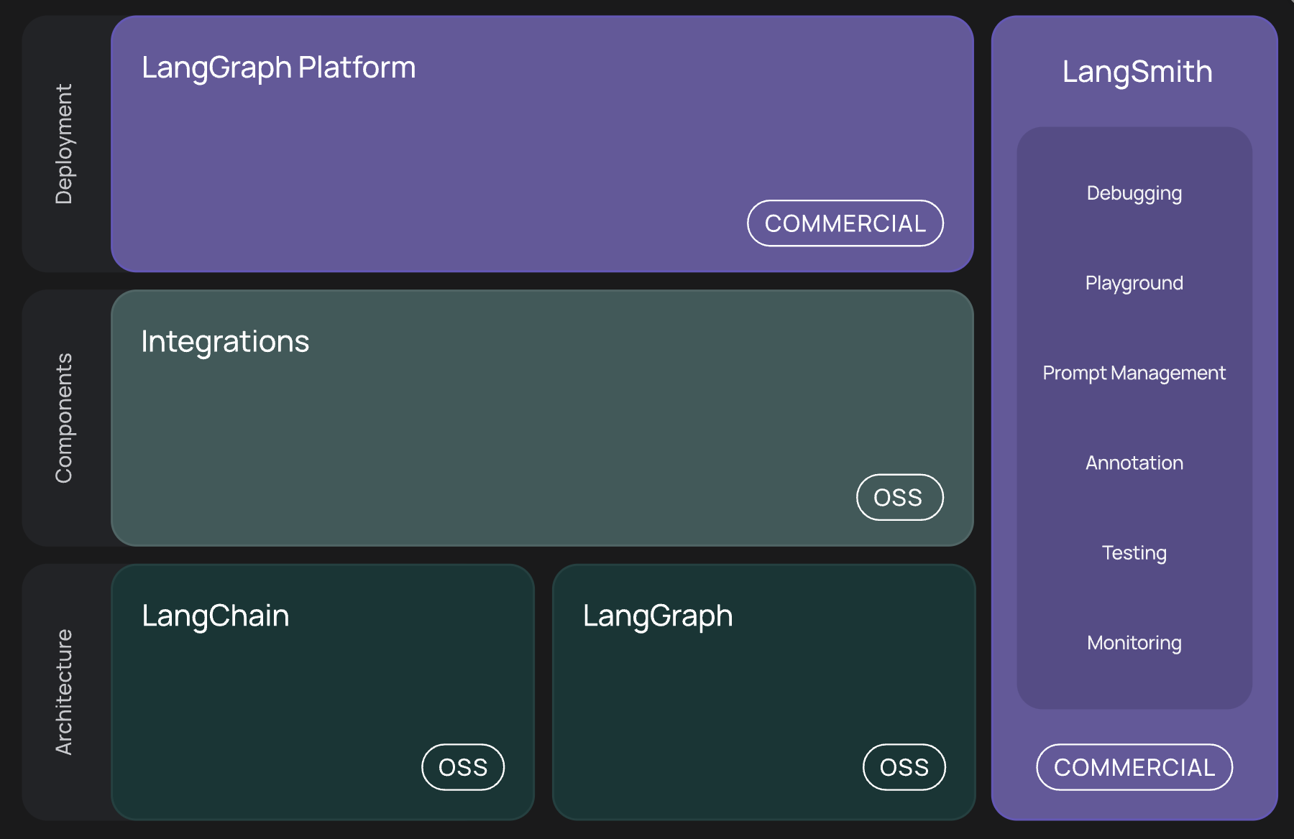
WTF is LangChain ?

Slide 11
News – LangChain Ecosystem
LangChain ecosystem matured in last 30 days—now production-grade, not just prototyping
Covers LangChain, LangGraph, LangSmith, plus industry traction & community signals
Focus: reliability, scale, enterprise readiness, and model optionality

Slide 12
News – LangChain Core
Model optionality: first-class connectors for GPT-5, LLaMA-4, Gemini 2 Ultra, Claude 4, Mistral, more
Download milestone: surpassed OpenAI Python SDK in monthly installs
Enterprise-grade plugins: SAP, Salesforce, ServiceNow, new vector stores, on-device models
Production templates: FastAPI + LangGraph starter, Docker files, multi-LLM configs
Memory upgrades: LangMem 0.0.22 adds better unstructured memory updates & default profiles

Slide 13
News – LangGraph
Platform GA: 1-click deploy, 30+ API endpoints, horizontal scaling, persistent agent memory
v0.4 orchestration features: interrupts, node-level caching, deferred nodes, streamable HTTP
LangGraph Studio V2: visual debugger, real-time state inspection
No-code Open Agent Platform: build & ship agents without writing code
Multi-agent workflows: async execution, shared context, robust error recovery

Slide 14
News – LangSmith
QWEN3
Tool use at the MOE Layer
Ollama support!
Gemini 2.5 IO
1 Million Tokens
Tool Use
Llama 4
Voice optimized model
Gemini 2.5 IO
1 Million Tokens
Tool Use
Deepseek
Deepseek-VL – Mulimodal Reasoning

Slide 15
News – LangSmith
Observability: agent-level metrics, multimodal tracing, cost tracking for OpenAI models
Interactive eval: LangSmith Playground, production failure alerts, webhook integrations
Self-Hosted v0.10: RBAC, workspace isolation, secure monitoring stack
Incident drill-down: 28-min TLS cert outage on May 1—quick fix validates monitoring roadmap
SDLC ties: bidirectional prompt sync with Git & issue trackers

Slide 16
News – Community Momentum
Enterprise adoption: Klarna, LinkedIn, Replit, BlackRock deploying LangChain agents at scale
Industry events: Interrupt 2025 showcased “agent engineer” role & live product demos
Community tooling: >30 new OSS plugins; surge in YouTube tutorials & case-study blogs

Slide 17
News – 30-Day Update Cheat-Sheet
LangChain: new models, plugins, prod templates, memory fixes
LangGraph: GA platform, caching, interrupts, no-code builder
LangSmith: multimodal tracing, self-host v0.10, cost & alerting
Ecosystem: enterprise case studies, agent-centric job roles, stronger focus on reliability

Slide 18
Lightning Talks
AG-UI – Ricky Pirruccio
AI Nuclear Fine Tunes – Rob Whelan
AI Ecosystem Update – Colin McNamara

Slide 19
Lightning Talk – Ricky Pirruccio
AG-UI – Ricky Pirruccio

Slide 20
Lightning Talk – Rob Whelan
AI Nuclear Fine Tunes – Rob Whelan

Slide 21
Lightning Talk – Colin McNamara
AI Ecosystem Update – Colin McNamara

Slide 22
Showcases
MCP Tox Testing – Ryan Booth
Panel – LangChain Interrupt

Slide 23
Showcase – Ryan Booth
MCP Tox Testing – Ryan Booth

Slide 24
Showcase – LangChain Interrupt Panel
Panel – LangChain Interrupt

Slide 25
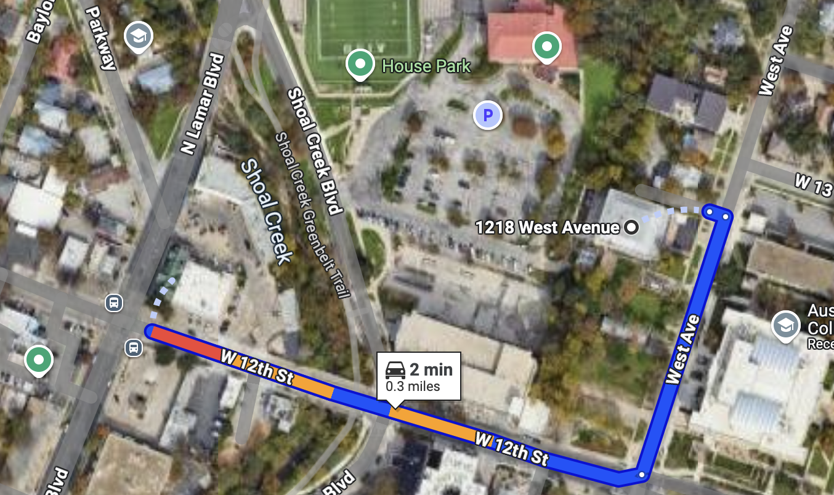
RGC-3000 and Tavern After Party
Website: aimug.org – All things LangChain and AIMUG.
Discord: Join us for ongoing conversations.
GitHub: Austin LangChain Repo – Check out our open-source projects.
Meetup: Austin LangChain Group
Twitter: @AustinLangChain – Latest updates and AI news.
YouTube: Austin LangChain Channel – Watch replays and tutorials.
ACC RGC3000
The Tavern
ACC Main Campus

Slide 26
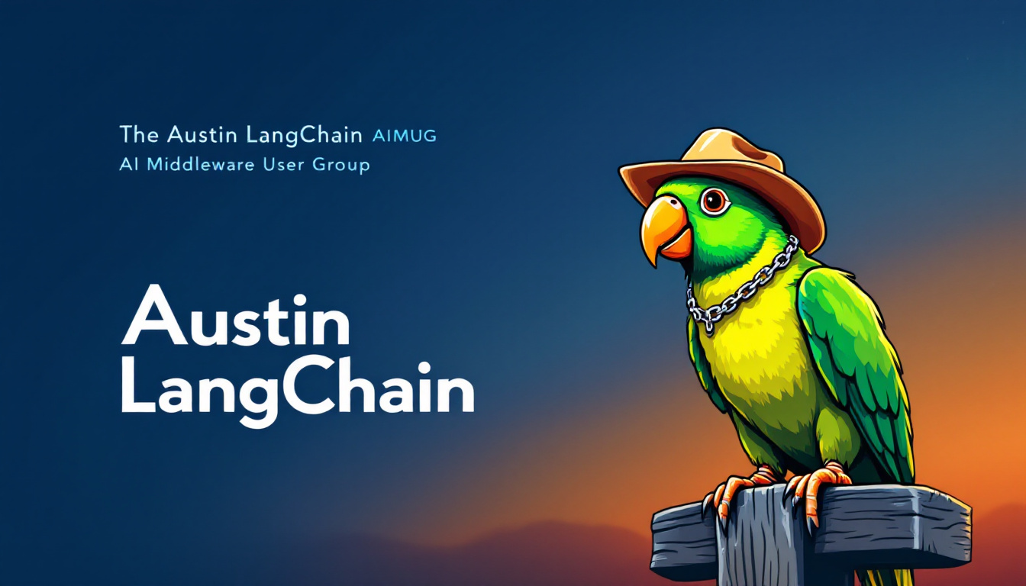

Slide 27
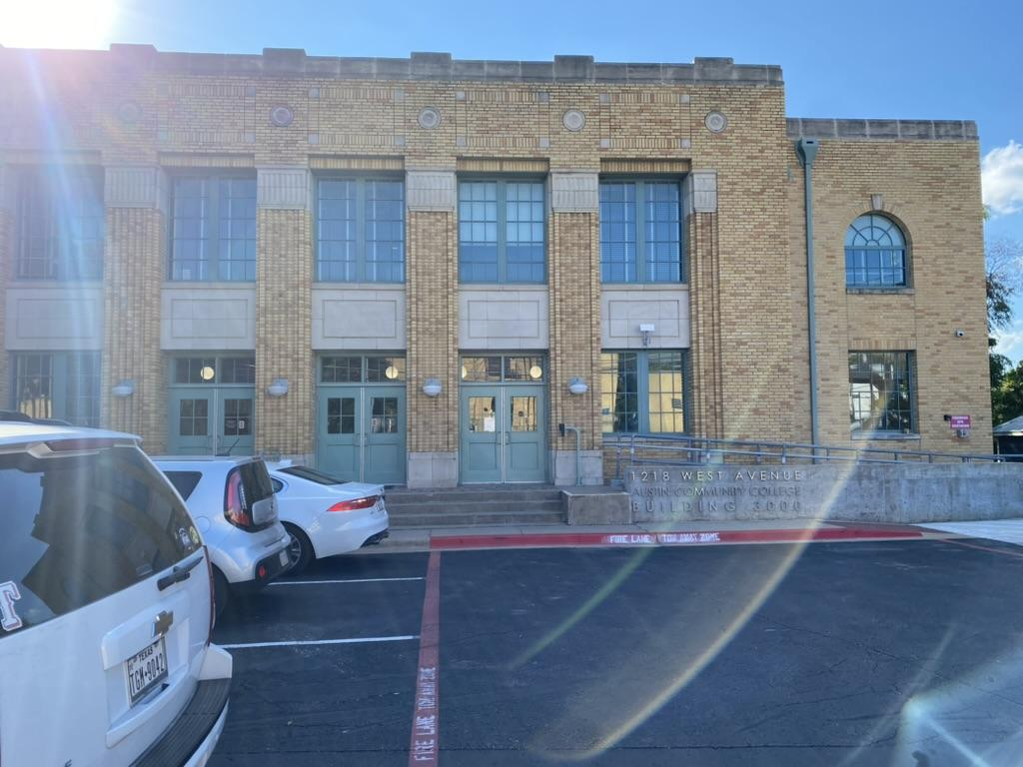
Finding US - ACC RGC-3000

Slide 28
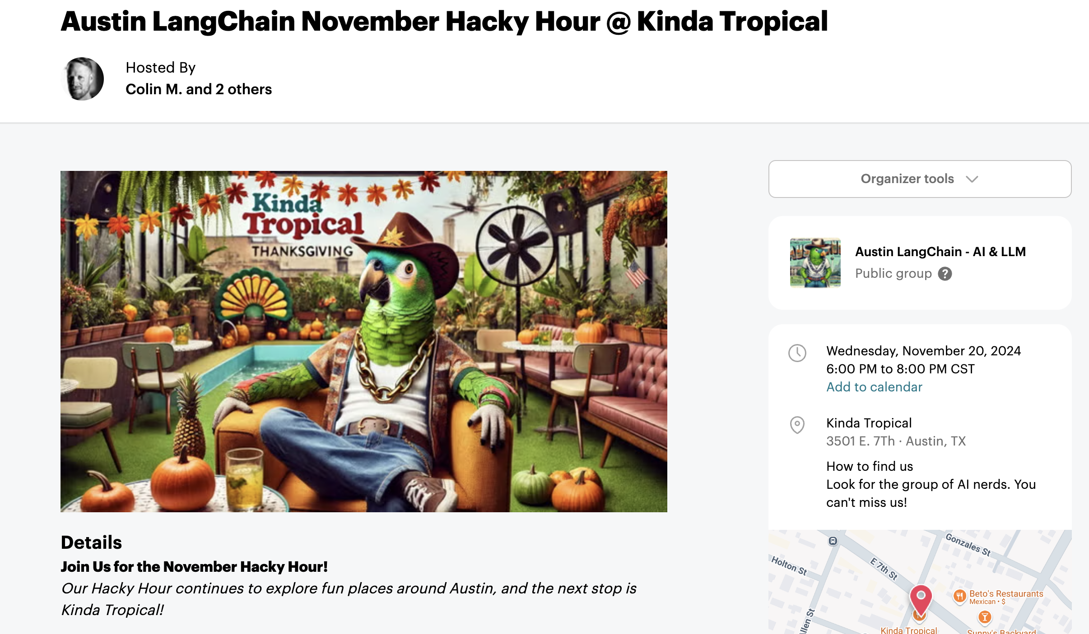

Next Event – Hacky Hour at Kinda Tropical
Respect & Inclusivity: Our only rule is simple: “Be cool to each other, don’t be gross.”
AI Enthusiasts of All Levels Welcome: We celebrate diverse perspectives and unique paths in AI.

